Slide 1
Intro

Slide 2
Introductions
Who is CanCode Communities?
Who are your instructors?
Icebreaker:
Why are you taking this course?
Have you programmed before? If so what languages?
What is your favorite hobby?

Slide 3
Expectations for the Course
You are expected to participate in class exercises.
Ask questions if you have them.
Reach out if you need additional help.
You should be completing any exercises assigned.
Please refer to your Welcome Guide for more detailed information on the expectations.

Slide 4
Outline of the Course
Notes:
Pull up course outline/syllabus in a separate document and briefly walk through it.

Slide 5
Intro to Python
Python is a programming language. It is very popular in the computer science industry.
The syntax of Python is straightforward.
Python is a great beginner language to get into programming.
Because of its popularity, Python has many tools available to use within and for it.
What are some things you would like to do with Python?

Slide 6
How to set up your IDE

Slide 7
How to use a .py file

Slide 8
Example
Let’s create a Python program that prints “Hello World!”

Slide 9
How to Code
How would you define programming, in your own words?

Slide 10
How to Code
Programming is the process of writing commands for a computer to follow.
An algorithm is a series of instructions to achieve a specific goal.
When developing code, we start by writing our algorithm in pseudocode.
Pseudocode is the steps for our algorithm, in no particular language, and easy to read for people.
Then we try to implement our algorithm in Python, and test it.
We will have to make changes to our code, and potentially our algorithm, and repeat.

Slide 11
Example
Let’s write an algorithm for driving a car in pseudocode.

Slide 12
Exercise
Write an algorithm for making a peanut butter and jelly sandwich in pseudocode.

Slide 13
Syntax vs Semantics
Syntax and semantics mean similar things in programming to what they mean in any language.
Syntax is the rules and regulations for writing a statement in code.
It doesn’t have anything to do with meaning.
It refers to the grammar and structure of the language.
A statement is syntactically correct if it follows all the rules.
Semantics is the meaning of a statement.
A statement is semantically correct if it does what you intend it to do.

Slide 14
Interpretation vs Compilation
Programs have to be translated into machine code so the computer can understand them.
Some programming languages are compiled, which means you have to put the code through a compiler that translates it into machine code before you can run it.
Some programming languages are interpreted, which means your code is automatically interpreted into machine code as you’re writing it.
Python is an interpreted language.

Slide 15
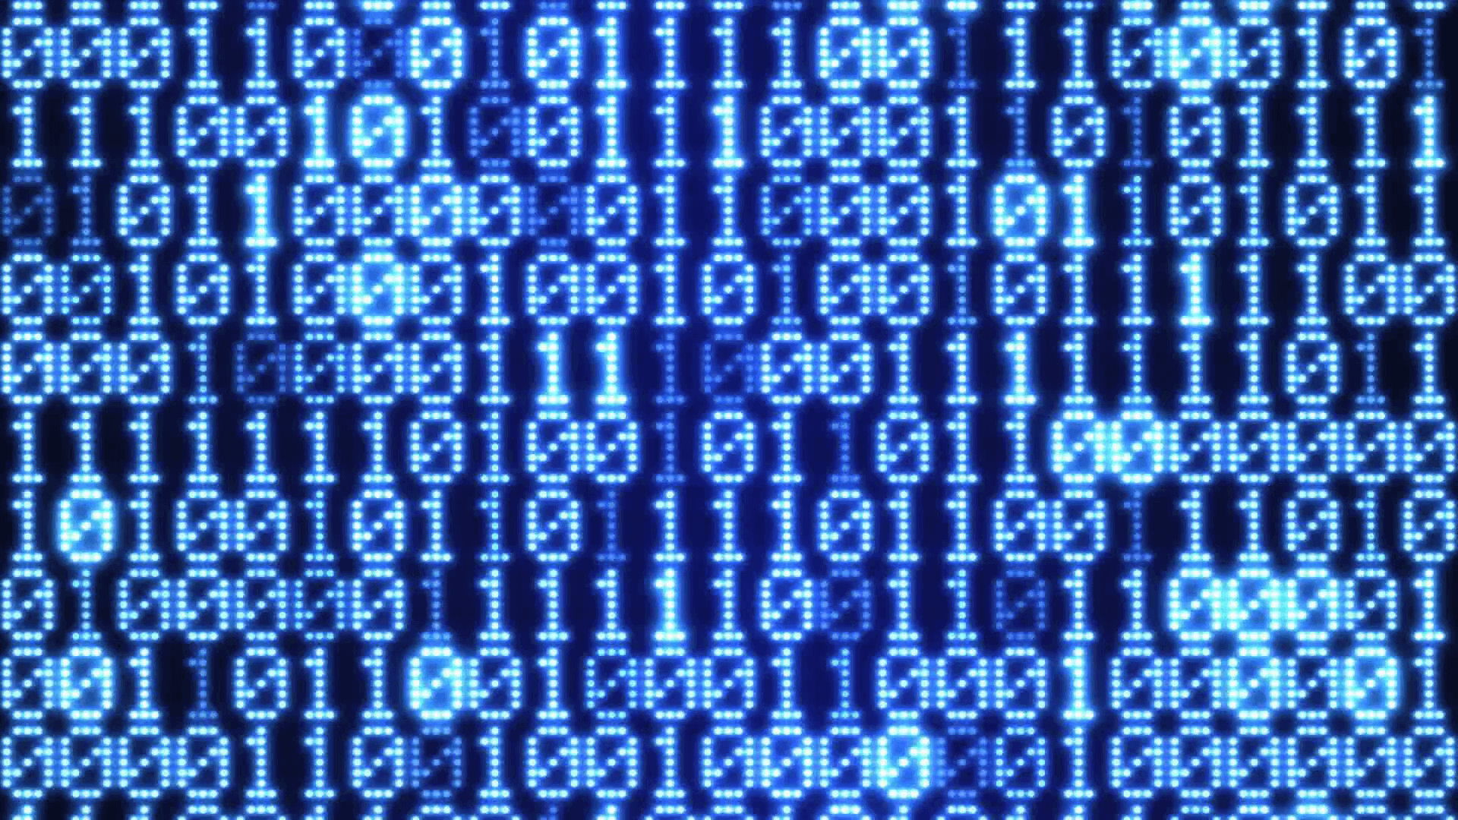
Binary
All the code you write is translated into binary so your computer can understand it.
The numbers we use are decimal (base 10), so there are 10 possible digits.
In contrast, binary is base 2, so there are 2 possible digits: 1 and 0.
A single digit in binary is called a bit.

Slide 16
Binary Example
Think about the number 102.
Decimal (Base 10):
1 0 2
10^2 10^1 10^0
(100) (10) (1)
Binary (Base 2):
1 1 0 0 1 1 0
2^6 2^5 2^4 2^3 2^2 2^1 2^0
(64) (32) (16) (8) (4) (2) (1)
1*100 + 0*10 + 2*1 =
100 + 2 = 102
1*64 + 1*32 + 0*16 + 0*8 + 1*4 + 1*2 + 0*2 =
64 + 32 + 4 + 2 = 96 + 6 = 102

Slide 17
Exercise
How would you represent the number 57 in binary?

Slide 18
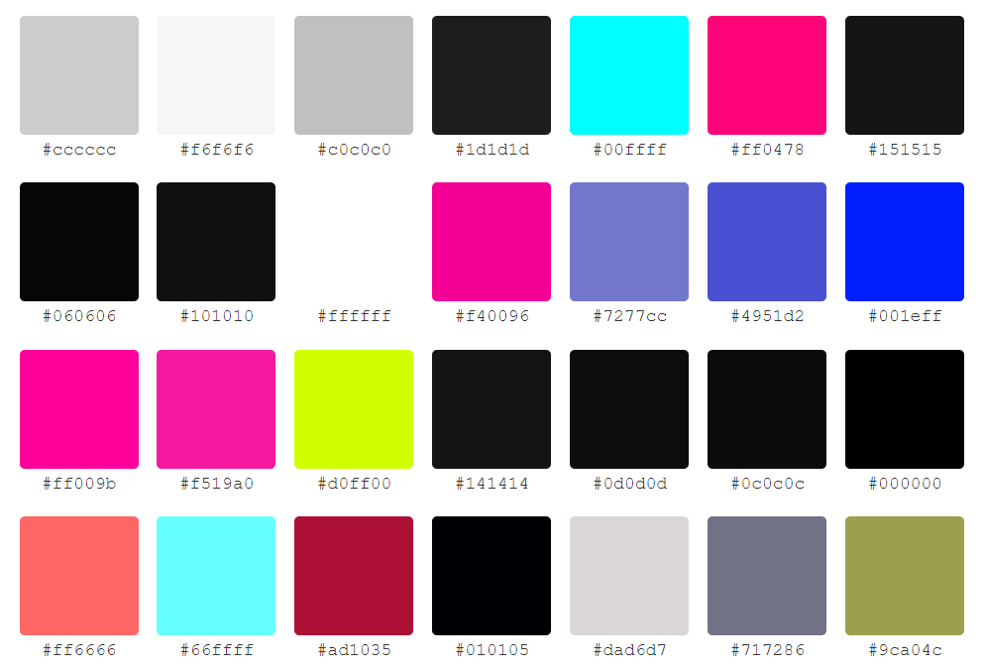
Different Bases
You can have a number system using any base.
Binary uses base 2, decimal uses base 10.
Other common systems are hexadecimal (base 16) and octal (base 8).
They all have different uses. For example, hexadecimal is used for color codes.

